Slide 1
Artificial Intelligence
Lecture 1, Chapter 1,2
Nuzhat Tabassum
Assistant Professor
Department of CS,AIUB
AI

Slide 2









Table of Contents
What is AI? Foundation of AI History of AI
What can AI do today? Intelligent Agents
The Nature Of Environments Specifying the task environment Properties of task environments
The Structure of Agents Exercise
References
1
2
3
4
5
6
7
8
9
AI

Slide 3
What is AI?
(The automation of) activities that we associate with human thinking, activities such as decision-making, problem solving, learning . . .” (Bellman, 1978)
“The study of mental faculties through the use of computational models” (Charniak+McDermott, 1985)
“The study of how to make computers do things at which, at the moment, people are better” (Rich+Knight, 1991)
“The branch of computer science that is concerned with the automation of intelligent behavior” (Luger + Stubblefield, 1993)
AI

Slide 4
What is AI?
Views of AI fall into four categories:
Thinking humanly | Thinking rationally
Acting humanly | Acting rationally
Suggested major components of AI: knowledge, reasoning, language understanding, learning.
AI

Slide 5
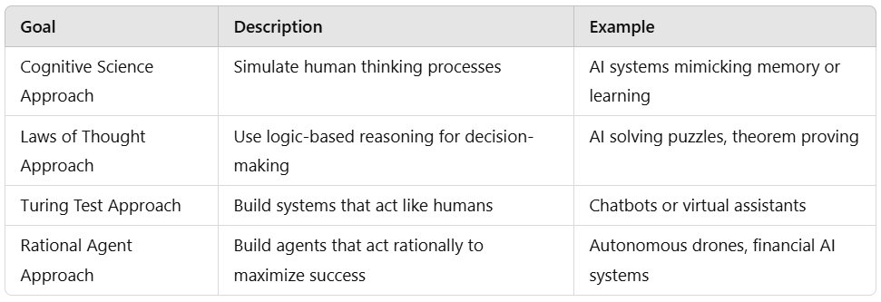
AI APPROCHES

Slide 6
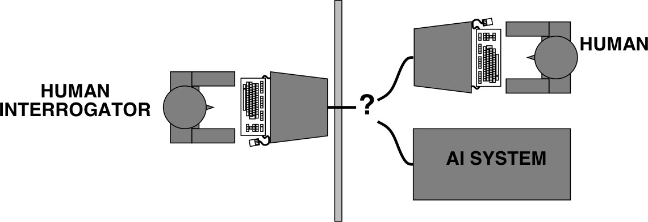
Acting Humanly: Turing Test
Turing (1950) ”Computing machinery and intelligence”: ”Can machines think?” ”Can machines behave intelligently?” The Imitation Game (2014)
AI

Slide 7
Thinking Humanly: Cognitive Modelling
How human thinks?
Two ways to determine a given program thinks like human (i)Through introspection , (ii)Through psychological experiments
After defining theory, we can express it as a computer program and check if it is behaving like human
AI

Slide 8
Thinking Rationally: Laws of Thought
Normative rather than descriptive
Aristotle was one of the first to attempt to codify “right thinking” – reasoning processing
AI

Slide 9
Acting Rationally
Rational Behavior: doing the right thing
Right thing: maximizes our goal achievement, given the available information.
Doesn’t necessarily involve thinking – but thinking should be in the service of rational action.
AI

Slide 10
Foundation of AI
Philosophy
logic, methods of reasoning mind as physical system
foundations of learning, language, rationality formal representation and proof
algorithms
computation, (un)decidability, (in)tractability probability
adaptation
phenomena of perception and motor control experimental techniques (psychophysics, etc.) knowledge representation
grammar
physical substrate for mental activity homeostatic systems, stability simple optimal agent designs
Mathematics
Psychology
Linguistics
Neuroscience Control theory
AI

Slide 11
history of AI
1943
1950
1952–69
1950s
McCulloch & Pitts: Boolean circuit model of brain Turing’s “Computing Machinery and Intelligence” Look, Ma, no hands!
Early AI programs, including Samuel’s checkers program,
Newell & Simon’s Logic Theorist, Gelernter’s Geometry Eng
1956
1965
1966–74
Dartmouth meeting: “Artificial Intelligence” adopted Robinson’s complete algorithm for logical reasoning AI discovers computational complexity
Neural network research almost disappears Early development of knowledge-based systems Expert systems industry booms
Expert systems industry busts: “AI Winter” Neural networks return to popularity
Resurgence of probabilistic and decision-theoretic methods Rapid increase in technical depth of mainstream AI “Nouvelle AI”: ALife, GAs, soft computing
1969–79
1980–88
1988–93
1985–95
1988–
AI

Slide 12
Until 2023, AIMA 3rd edition
AI Tools
Robotic vehicles Speech recognition Game playing
Autonomous planning and scheduling Spam fighting
Robotics
Machine Translation
AI

Slide 13
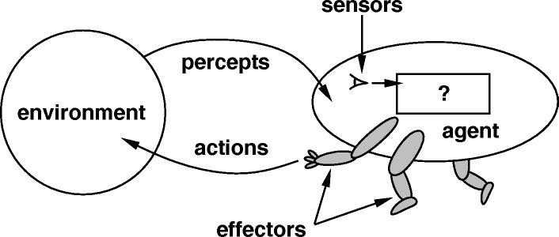
Intelligent Agents
An agent is anything that can be viewed as perceiving its environment through sensors and acting upon that environment through effectors.
Our aim is to design agents.
A rational agent is one that performs the actions that cause the agent to be most successful.
Web search engines (ranking relevant results)
Recommendation systems (Netflix, Amazon)
Autonomous robots (drones, Mars rovers)
Game AI (NPCs that adapt and respond)
Smart assistants (Alexa, Siri)
AI

Slide 14
Rational Agent
An agent is an entity that perceives and acts. Abstractly, an agent is a function from percept histories to actions:
f : P∗ → A
Doesn’t necessarily involve thinking – but thinking should be in the service of rational action.
For any given class of environments and tasks, we seek the agent with the best performance
Target is to design best program for given machine resources.
AI

Slide 15
Structure of Intelligent Agents
The job of AI is to design the agent program: a function that implements the agent mapping from percepts to actions. We assume this program will run on some sort of computing device call the architecture.
The architecture makes the percepts from the sensors available to the agent program. runs the program and feeds the program’s action choices to the effectors as they are generated.
agent=architecture + program
AI

Slide 16
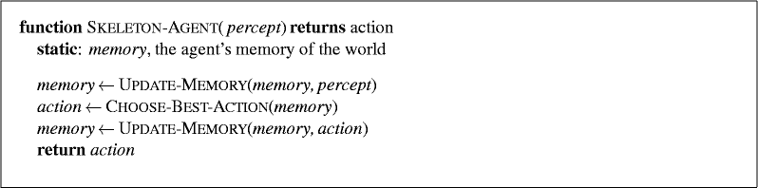
Agent Programs
The agent function maps percept sequences (i.e., inputs over time) to actions.
It aims to choose the best action to maximize performance based on a performance measure.
All agent programs have roughly the same skeleton; they accept percepts from the environment and generate actions.
AI

Slide 17
Specifying the task environment
PEAS (Performance, Environment, Actuators, Sensors)
Must first specify the setting for intelligent agent design. Consider, e.g., the task of designing an automated taxi:
Performance: Safe, fast, legal, comfortable trip, maximize profits
Environment: Roads, other traffic, pedestrians,customers
Actuators: Steering, accelerator, brake, signal, horn, display
Sensors:Cameras, sonar, speedometer, GPS, odometer, accelerometer, engine sensors, keyboard
AI

Slide 18
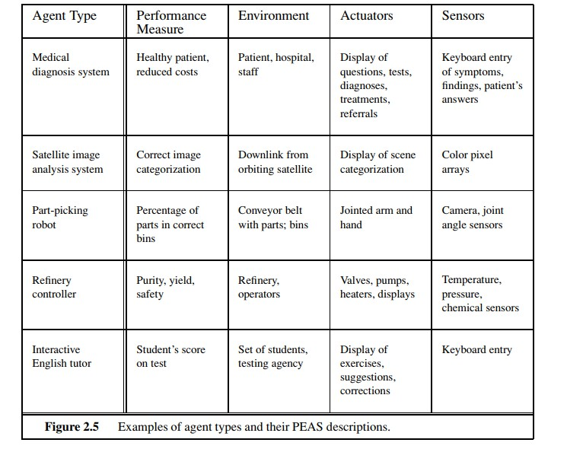
agent types and their PEAS descriptions.
AI

Slide 19
Properties of task environments: Environment types
Fully observable (vs. partially observable): An agent’s sensors give it access to the complete state of the environment at each point in time.
Deterministic (vs. stochastic): The next state of the environment is completely determined by the current state and the action executed by the agent. (If the environment is deterministic except for the actions of other agents, then the environment is strategic)
Episodic (vs. sequential): An agent’s action is divided into atomic episodes. Decisions do not depend on previous decisions/actions.
AI

Slide 20
Environment types - cont.
Static (vs. dynamic): The environment is unchanged while an agent is deliberating. (The environment is semidynamic if the environment itself does not change with the passage of time but the agent’s performance score does)
Discrete (vs. continuous): A limited number of distinct, clearly defined percepts and actions. How do we represent or abstract or model the world?
Single agent (vs. multi-agent): An agent operating by itself in an environment. Does the other agent interfere with my performance measure?
AI

Slide 21
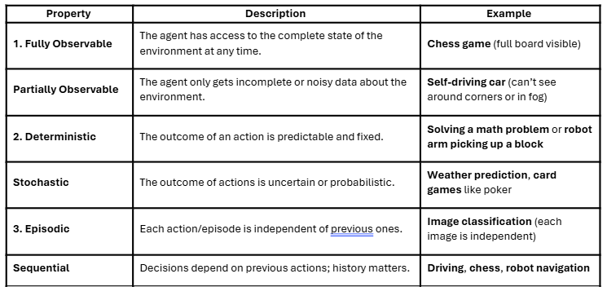
Examples

Slide 22
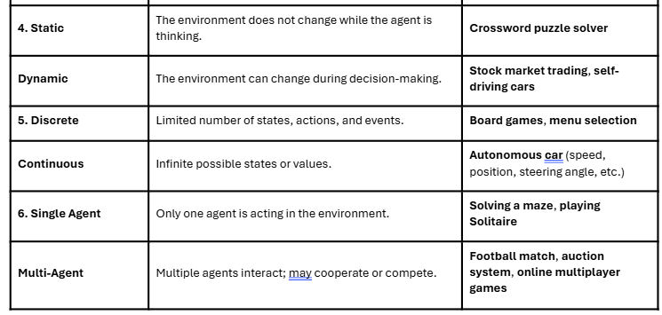
Examples

Slide 23
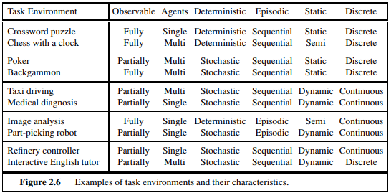
Task and Environment
AI

Slide 24
kinds of Agent Programs
Four basic kinds of agent programs that embody the principles underlying almost all intelligent systems:
Simple reflex agents;
Model-based reflex agents;
Goal-based agents;
Utility-based agents.
AI

Slide 25
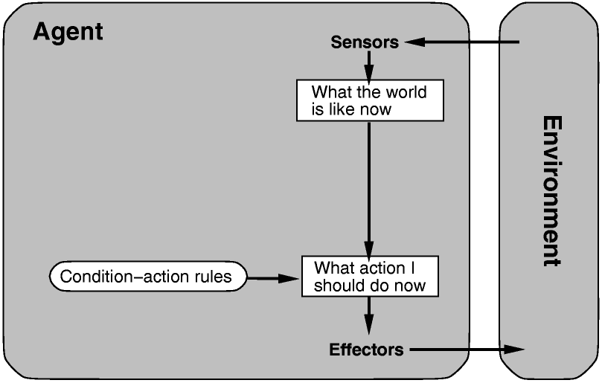
Simple reflex agents
​
select actions on the basis of the current percept, ignoring the rest of the percept history. ​Automatic door (opens when motion is detected)
Works only if the Environment is
Fully Observable
AI

Slide 26
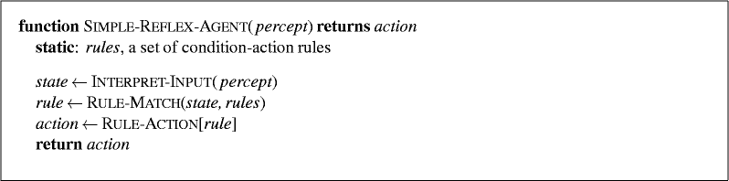
Simple reflex agents Algorithm
If condition then action
AI

Slide 27
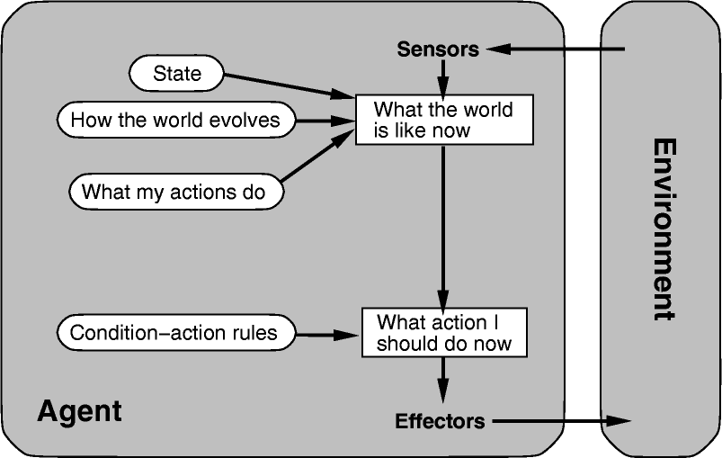
Model-based reflex agents
Agents that keep track of the world(state). Vacuum cleaner that remembers where it has cleaned
AI

Slide 28
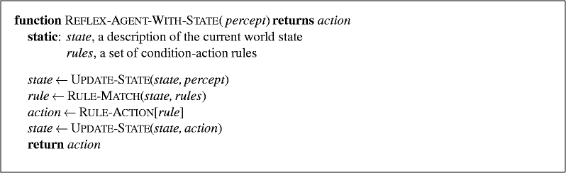
Model-based reflex agents Algorithm
AI

Slide 29
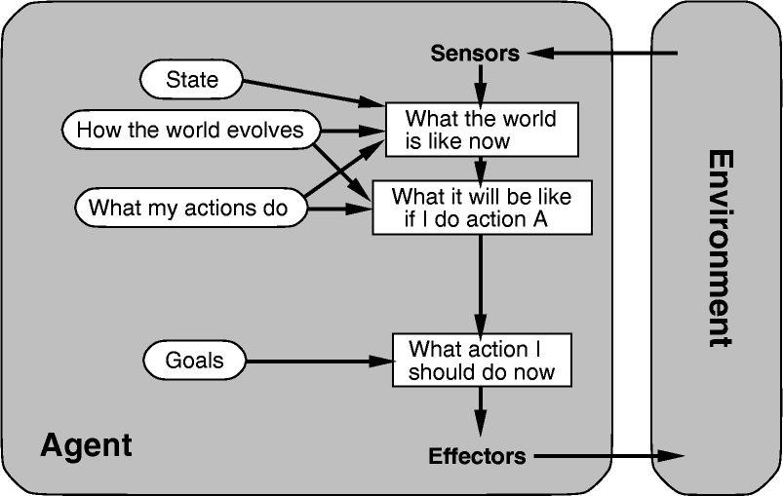
Goal-based agents
Search and Planning are the sub fields of AI devoted to finding action sequences that achieve goals. Pathfinding robot that plans to reach a destination
AI

Slide 30
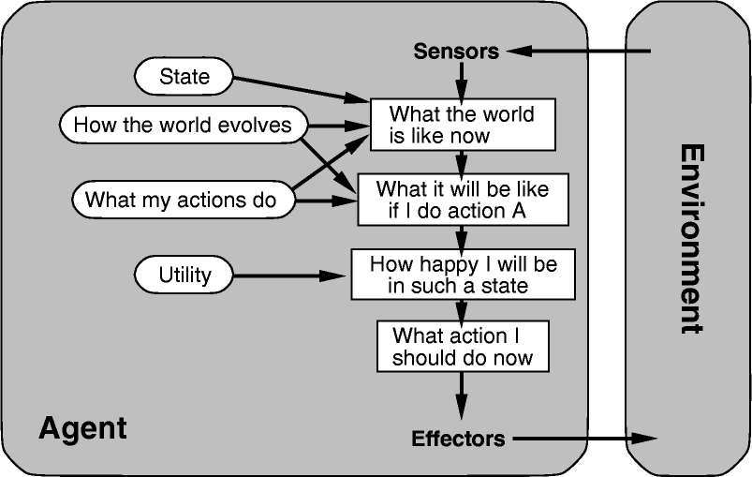
Utility-based agents
Goals alone are not enough to generate high-quality behaviour. For example, there are many action sequences that will get the taxi to its destination, but some are quicker, safer, more reliable, cheaper, etc. Self-driving car choosing the fastest and safest route
AI

Slide 31
UTILITY-BASED AGENTS
An agent’s utility function is essentially an internalization of the performance measure. If the internal utility function and the external performance measure are in agreement, then an agent that chooses actions to maximize its utility will be rational according to the external performance measure.
In two kinds of cases, goals are inadequate, but a utility-based agent can still make rational decisions.
when there are conflicting goals, only some of which can be achieved (for example, speed and safety), the utility function specifies the appropriate tradeoff.
when there are several goals that the agent can aim for, none of which can be achieved with certainty, utility provides a way in which the likelihood of success can be weighed against the importance of the goals.

Slide 32
Exercise Questions
Reading Assignment
Artificial Intelligence: A Modern Approach Textbook by Peter Norvig and Stuart J. Russell
Chapter 1, Chapter 2
AI

Slide 33
References
Stuart Russell and Peter Norvig. 2009. Artificial Intelligence: A Modern Approach (3rd ed.). Prentice Hall Press, Upper Saddle River, NJ, USA.
https://www.cs.cmu.edu/ 15281/coursenotes/search/ https://inst.eecs.berkeley.edu/ cs188/sp22/
AI

